Slide 1
Building
workforce solutions
Responsive
Agile
Transferable

Slide 2
Te Hiku Landscape
Source MSD 2022
Source MOE 2023

Slide 3
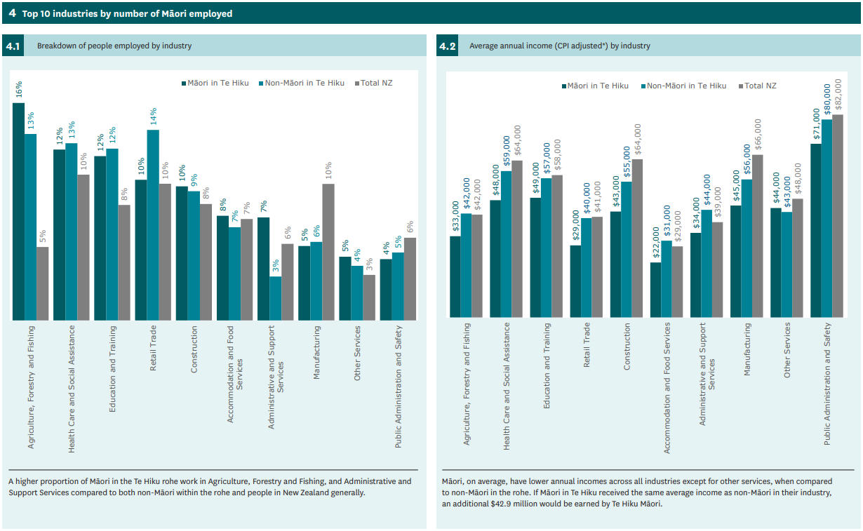
Source MSD 2022

Slide 4
Building
workforce solutions
Responsive
Agile
Transferable
Customised solutions,
Learner centric, Sustainable delivery
Earn Learn,
Transitions,
Pathways to progression
Stackable,
Cross-creditable,
Embed core employability skills, Tupu conditions

